Slide 1
Tasty Recipe
A Food Blog which would make u crave for...
http://sairamredekar09.wordpress.com

Slide 2
Overview
Introduction to the Objective
Content of Blog
Summary of Recipes
Conclusion

Slide 3
OBJECTIVE
BEHIND BLOG
This Blog would contain a detail description about our upcoming food ordering website and the recipes u would find in it.

Slide 4
Blog Content
Home Page
01
This gives an idea of the blog’s actual content.
Contains a View menu option where you could view the different menus.
Coming Soon
02
This contains food recipes which would be soon released in menu option.
Contains images of the upcoming menus.
Contact
03
Will contain details regarding the address of the restaurant.
Message option through which user can connect us.
About us and Developer Info
04
This would mainly contain a detail of our page.
Developer Info contains details of the developer who bult the blog and website.

Slide 5
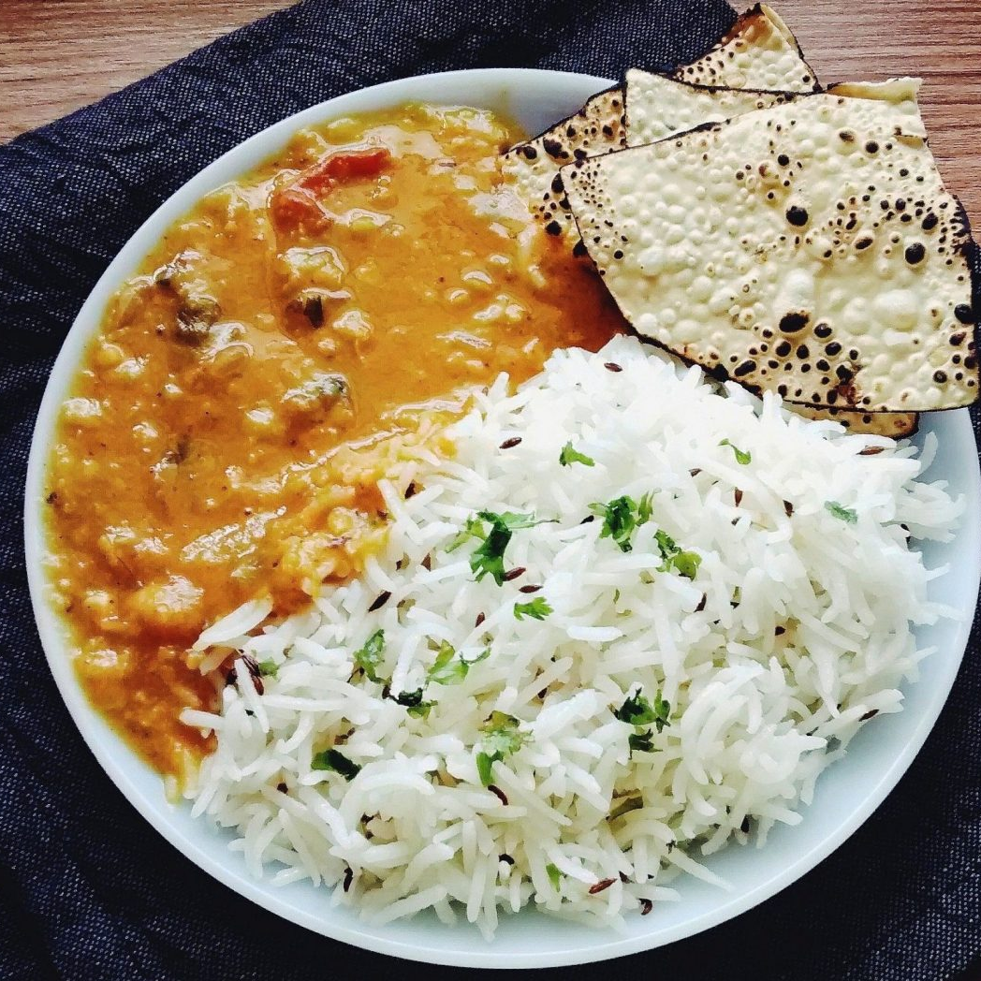
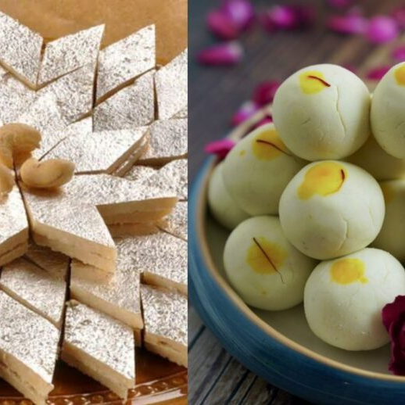
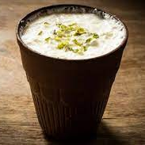
Menus We Have
Veg
Non Veg
Dessert
Indian Drinks
Indian
Indian/Korean
Indian / Other
Various Special Drinks
Mainly Contains Indian recipes and a mix of Indo Chinese taste.
Cuisines available in different ways like roast, grill, cooked and boiled.
Different Idian and other regional desserts and sweet dishes.
Drinks designed by our special chefs with lots of love stuffed inside.

Slide 6
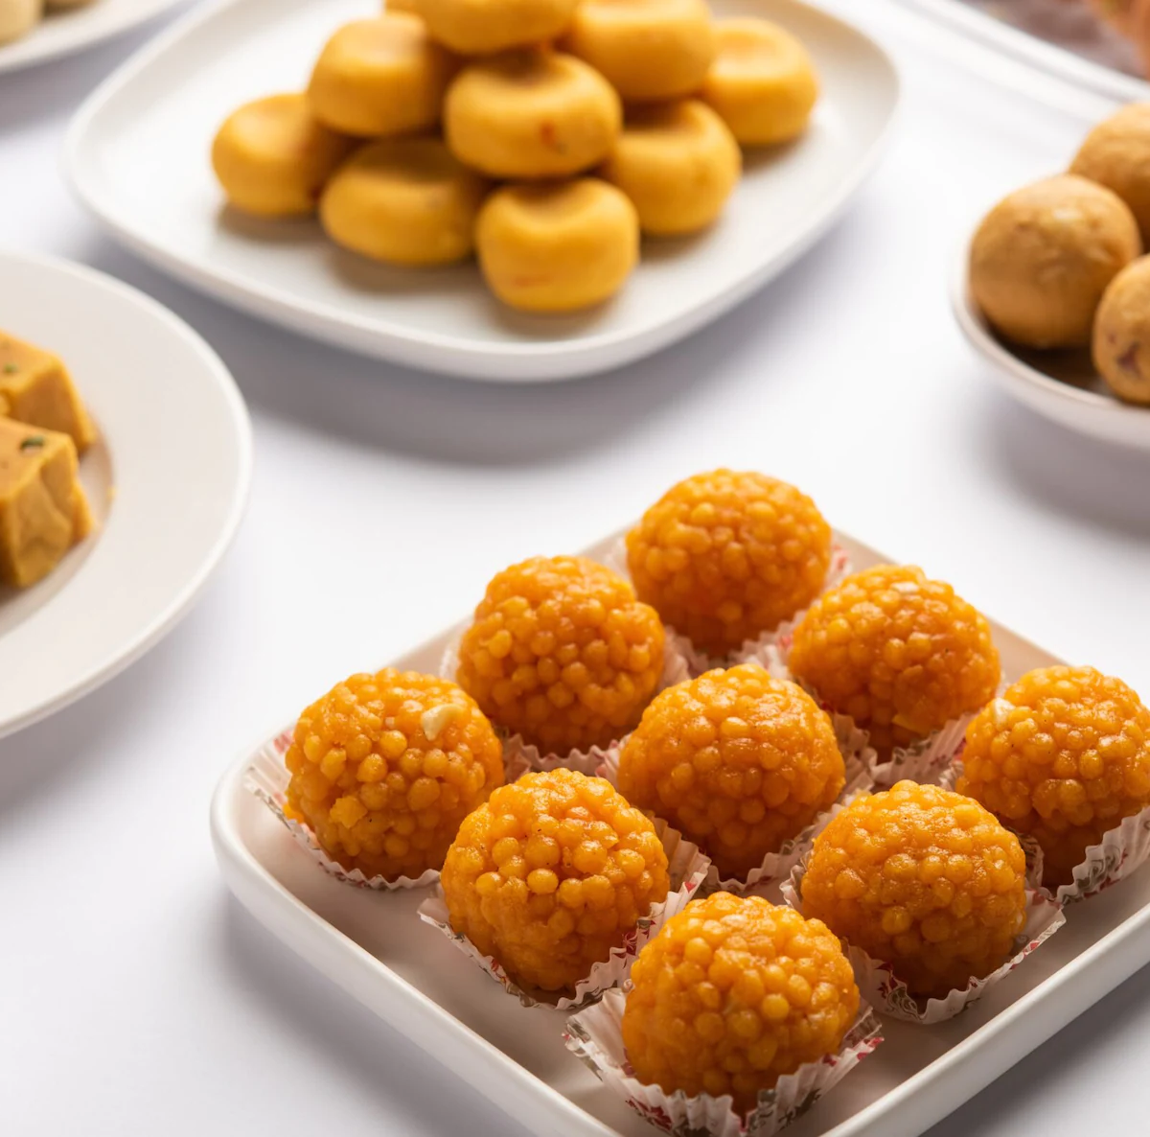
Things We Have Took
Care Of…
Users Reviews
Contains “Leave a Reply & Send Us Message ”.
Can be utilized for collecting users feedback and inquiries .Users can submit their questions or concerns through the form and then the support team can access and respond to their queries.

Slide 7
THANK YOU
Insert the Subtitle of Your Presentation

